Slide 1

外研新标准
第八册 选修8

Slide 2
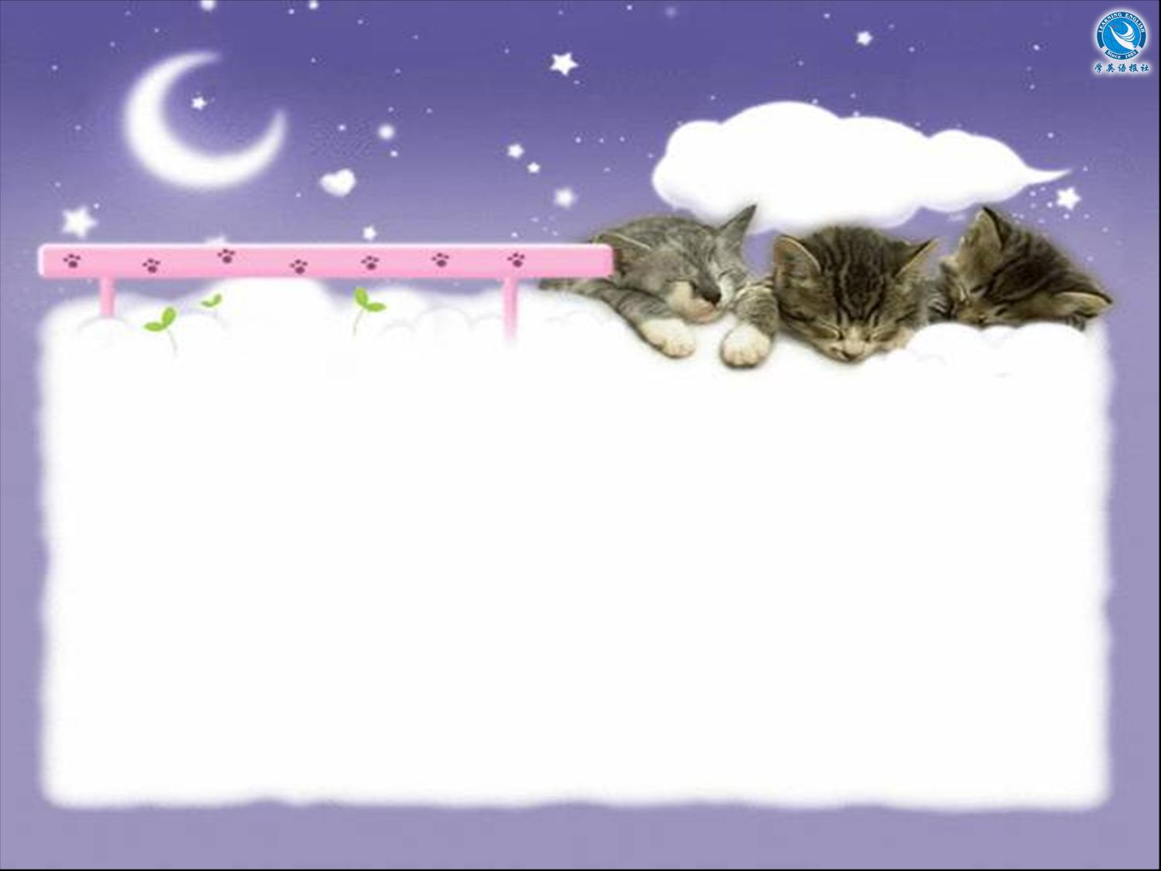

Module 4
Listening

Slide 3


Objective
能识别听力中新学的词汇、短语并正确理解其含义。能听懂对话中主要内容并提取信息。

Slide 4


Listen to the four conversations.

Slide 5


Listen again and fill in the blanks.
Conversation 1
Man: Excuse me, what time does the train
___ Cardiff leave?
Station Porter: It's already left, _____.
Man: What?
Station Porter: That's right. You've ______
it. It left at 10:15.
Man: But I've been here since ten o'clock!
for
mate
missed

Slide 6
Station Porter: Yes, but you're waiting
in the ______ _____, aren't you? The
Cardiff train goes from Platform 8.
Man: When's the next one?
Station Porter: It's __ ____ _____.
Man: Oh no!
wrong place
in two hours

Slide 7
Conversation 2
Woman: I need to get a bus. I'm __ __
_____.
Man: Where you want to go, missus?
Woman: I gotta to get to the hospital, but I
can't see no bus.
Man: The bus is late. It ___ ____ ___ in the
traffic. You just sit in the shade here. The
bus won't be long now.
Woman: I hope you're right. I haven't got
time __ _____.
in a
hurry
got held up
to waste

Slide 8
Conversation 3
Man: Excuse me, the flight to Sydney
hasn't _____ ___ on the screen yet.
Woman: No, sir. The flight has been
_______. We don't know when it will be
leaving.
Man: But what's happened?
Woman: Er, there's been a ________
problem.
come up
delayed
technical

Slide 9
Man: What's that mean, a technical
problem? Have the wings fallen off, or
something? Can't you give me a
_______ ______, and just say what's
happened?
Woman: I'm sorry sir. I've got ___ ____
what's happened.
straight answer
no idea

Slide 10
Conversation 4
Man: Are you ____?
Taxi driver: Yes sir. Sit in the front seat,
please, if you don't _____.
Man: Can't I sit in the back?
Taxi driver: There's a problem with the
back seat. The last passenger ____ tea
all over it. It's still __ __ ____.
free
mind
spilt
a bit wet

Slide 11
Man: Oh. __ ____ ____, perhaps I'll
just wait for another taxi.
Taxi driver: Could be a long wait.
Man: __ ______ ______, I'd rather not
sit in the front.
Taxi driver: As you wish.
In that case
It doesn't matter

Slide 12

Thank you.

